Slide 1
Transforming Care Delivery with
Home-Based Medical Care
Bruce Leff, MD
Professor of Medicine
Johns Hopkins University School of Medicine
Health TechNet
March 15, 2024

Slide 2
Hospital at Home Will Be Mainstreamed into the
US Healthcare Delivery System

Slide 3
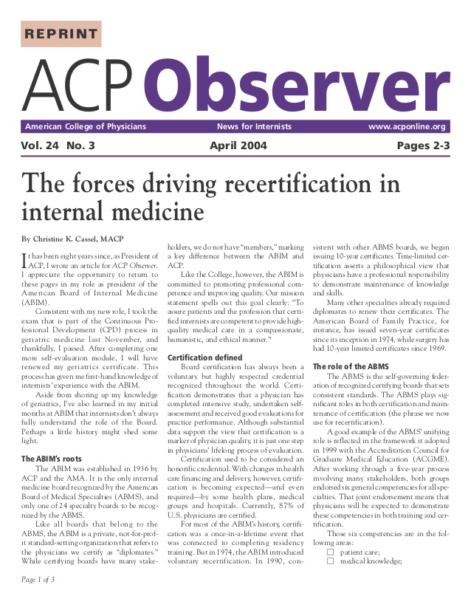

Seeing Patients as People: Why I’m a Home Care Physician
By Bruce Leff, ACP Associate

Slide 4
My Early Mental Map of Home-Based Care
Informal Services
Formal Personal Care Services
Skilled Home Health Care
Home-Based Primary
Care
Hospital at Home
10–15M
2M
3.4M
~300K
~100K
Low Acuity
High Acuity
Chronic Care
Acute Care
Little or No MD Involvement
High Level
MD Involvement
IOM Workshop: The Future of Home Health Care, 2015

Slide 5

Why We Need Hospital at Home?”
Walter’s Gripes
“I can’t get breathing treatments on time so I end up on a ventilator”
“Food stinks”
“No one talks to me”
“I got confused and tied down”
“I always come home with a completely new set of medicines”
JAMA. 2011;306:1782; Ann Intern Med. 1993;118:219; N Engl J Med. 2013;368:100

Slide 6
“Why Hospital at Home? ”
Traditional Hospital Care is Inherently Unsafe
Adverse events in 1 of 4 admissions
23% are preventable
33% caused serious harm – resulted in substantial intervention or prolonged recovery
15% associated with nursing care
New England Journal of Medicine 2023;388:142
These rates of adverse events are unchanged from landmark studies of the safety of hospital care conducted in the 1990s

Slide 7
The “Why” - Traditional Hospital Care is Particularly Unsafe and Challenging for Older Adults
Delirium
Falls
Immobility
Disability
Incontinence
Adverse drug events
Nosocomial infections
Pressure sores
JAMA. 2011;306:1782; Ann Intern Med. 1993;118:219; N Engl J Med. 2013;368:100. J Geront Med Sci 1999;554A:M377.

Slide 8
Walter Got Sick….

Slide 9




Hospital at Home
Assessment
Transport
Care
Discharge
Source: Watch interview, 5/8/06; Naik, Wall Street Journal, 4/19/06; Ann Intern Med. 2005;143:798. .

Slide 10
Hospital at Home Substitutes for Acute Inpatient Care
HaH is an acute clinical service that provide hospital care in patients’ homes
  Episodic - clear start and end day
  Provides all medical, nursing, allied care, pharmacy, and radiology care during the episode; and includes observation, diagnostics and therapeutics at home
  Provides 24 / 7 care
  Care that is hospital-directed by hospital-level physicians
  Meet regulatory and governance obligations of hospital care
  Consented to by patients with the right of transfer back to a inpatient hospital ward
HaH is not:
  Outpatient antimicrobial therapy (OPAT) or self-administered intravenous therapy;
  Chronic disease management program
  Solely virtual care or remote patient monitoring
  Home-based primary care
  Skilled home health care
J Am Geriatr Soc. 2004;52:2141.

Slide 11
Hospital at Home Started Decades Before COVID
US HaH Development Begins at Johns Hopkins – Early Work and Pilot Studies
Center for Medicare and Medicaid Innovation (CMMI) HaH Study at Mount Sinai NY
CMS Acute Hospital Care at Home Waiver (AHCaH)
HaH Users Group Established
1970s-90s | 1994-1999 | 2005 | 2014-17 | 2018 | 2019 | 2020 | 2022 | 2023+
Additional US Trials of HaH
Consolidated Appropriations Act of 2023 – Extends AHCaH Waiver Through 12/2024
HaH Studies aand Development and Implementation of HaH in Australia, New Zealand, UK, France, Italy, Israel
National Demonstration Study of HaH in Medicare Advantage Plans and VA
Implementation of HaH in Medicare Advantage & VA

Slide 12
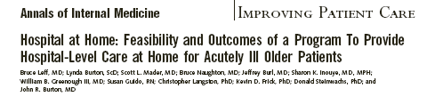

61% chose HAH care
High-quality care
Fewer complications
Better patient /family experience
Lower costs of care
Less CG stress
Better function
High provider satisfaction
Ann Intern Med. 2005;143:798. J Am Geriatr Soc. 2006;54:1355. J Am Geriatr Soc. 2008;56:117. Am J Manag Care. 2009;15:49.. J Am Geriatr Soc. 2009;57:273. Medical Care, 2009;47(9):979.

Slide 13
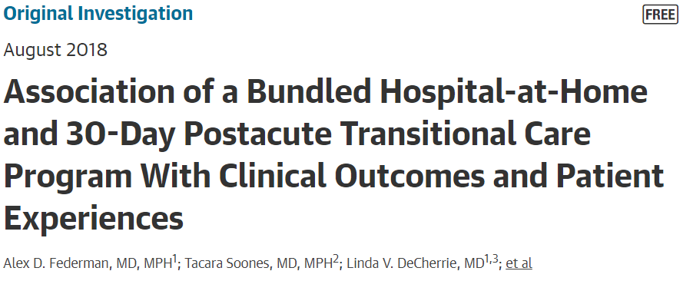

 | HaH N=295 | Control N=212 | Adjusted OR
Acute LOS (days) | 3.2 | 5.5
Readmission, all cause | 8.6% | 15.6% | 0.43 (0.31,0.52)
ED visits, all cause | 5.8% | 11.7% | 0.39 (0.31,0.49)
Highest overall experience rating | 68% | 46% | 3.12 (2.63, 3.70)
Discharge to SNF | 1.7% | 10.4% | -8.7%
Overall costs | $11,875 | $13,133 | -$1259
JAMA Intern Med. 2018;178:1033-1040

Slide 14
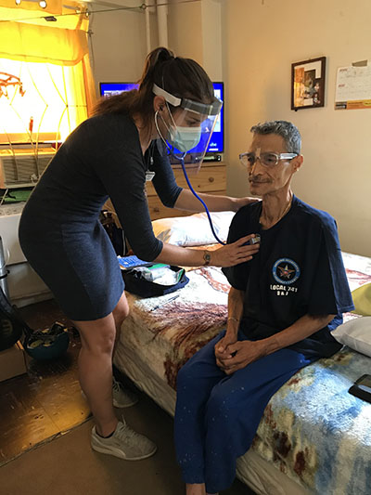
Reduced utilization during the acute hospitalization
  Fewer labs (3 v 15 labs per admission)
  Fewer radiology ( 14% v 44%)
  Fewer consultations (2% v 31%)
Same safety and quality –
  Similar rates hospital-acquired complications, pain scores
  No patients transferred back to hospital
Improved physical activity – 32% v 66% of the day lying down
Lower costs for acute episode – 38% lower
Reduced post-acute utilization
  Readmission 30d (7% v 23%)
  ED 30d (7% v 13%)
Ann Int Med 2020;172:77-85

Slide 15
Hospital at Home is Among the Most Studied Health Service Delivery Innovations of the Last 50 Years – The Evidence Base is Enormous
Safe and high-quality
Fewer complications than traditional hospital
  Lower rates of delirium
  Lower rates of sedative medication use
  Lower rates of urinary catheters use
  Lower rates of nosocomial infections
  Lower mortality – DEAD OR ALIVE – NNT= 50 to prevent 1 death
Better patient and caregiver care experience
Less caregiver stress
Patients more active and mobile at home
High provider satisfaction
Lower rates 30-day emergency department visits and hospital readmissions
Lower rates skilled nursing facility admissions
Equitable care that addresses social determinants of health
Can be accomplished in rural areas
Approximately 80 randomized controlled trials, multiple systematic reviews and meta-analyses of the evidence
If HaH were a drug it
would be a blockbuster!!

Slide 16
What Did Walter Think?
I definitely would have ended up on a breathing machine if I had been in the hospital.”
“It was great to get the attention from the nurses and to have the doctor see me at home.”
“I didn’t have to worry about my cat.”

Slide 17

Goal: Move from Research to Practice and Mainstream

Slide 18

Leadership, Backwards Bicycles, and Culture Change

Slide 19
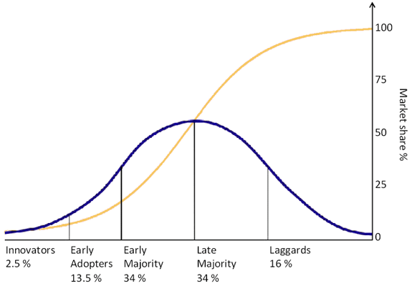
Payment: CMS Acute Hospital Care at Home Waiver – November 2020
Waived requirement for on-site 24/7 nursing
All other hospital conditions of participation apply
Must operate under state requirements
CMS reported on first 11,000+ pts (1011 duals)
  Median LOS 5 days
  Escalation 7.2%
  0.34% unanticipated mortality with nearly all escalated
Claims analysis
  Diverse group of complex patients: HCC 3.15
  Low SNF utilization: 2.6%
As of 1/26/24, 311 hospitals, 130 systems in 37 states have been approved for the waiver
- Ann Intern Med. 2021;174:1772-1774
- JAMA Health Forum. 2023 Nov 3;4(11):e233667. doi: 10.1001/jamahealthforum.2023.3667
- Ann Intern Med. 2024 Jan;177(1):109-110. doi: 10.7326/M23-2264. Epub 2024 Jan 9.

Slide 20

Supply Chain and Logistics
Photo courtesy of Dr. Al Siu

Slide 22
Health Care Equity in Hospital at Home Center for Medicare and Medicaid Innovation Demonstration (CMMI)
Medicaid and low SES rates similar in both HaH and hospital groups
  ~40% Medicaid in each group
  55-60% with low SES – public housing or census block with deprivation
Length of stay was lower in HaH regardless of SES – about 1.5 -2 days
30-day ED visits significantly reduced in patients with Medicaid favoring HaH
J Am Geriatr Soc. 2022;70:2153-2156.

Slide 23
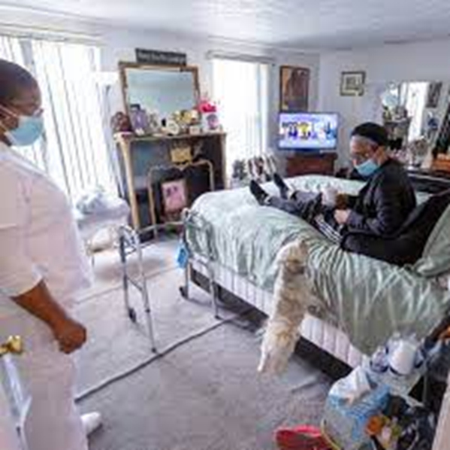
Outcomes of Hospital at Home for Older Adults with and without High Levels of Social Support – HaH CMMI Demonstration Study
Question: Did availability of social support alter the effectiveness of HaH care?
HaH patients had lower levels of social support at home, but that did not affect outcomes
  hospital length of stay
  30-day emergency department or hospital readmission
  referral to skilled nursing facility
HaH care was able to recognize and fill gaps of social support during HaH care –information about treatment, assess the home environment, communicate with primary care physicians, and arrange for assistance, including home health aides
Home Healthc Now. 2021 ; 39(5): 261–270

Slide 24
Family Caregivers of HaH Patients

Slide 25

Technical Assistance and Research
Foundation-funded
Over 150 member HaH programs and >300 affiliates working to launch or support HaH
Facilitate an active online community with over 3000 participants
Open source free technical assistance
Workgroups focused on HaH program standards, quality metrics, policy and payment, and tech
J Am Geriatr Soc. 2022;70:1060-1069
hahusersgroup.org

Slide 26



Hospital of the Future

Slide 27
https://www.chcf.org/publication/medical-care-home-comes-age/

Slide 29

With Leadership and Culture Change…
MJA 2010;193:598
New York Times, 2015-present

Slide 30
Hospital at Home Is Entering the Mainstream of US Health Care Delivery

